Slide 1
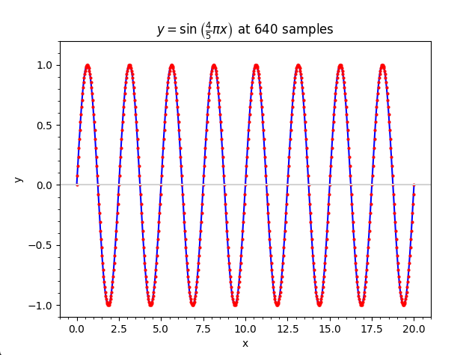
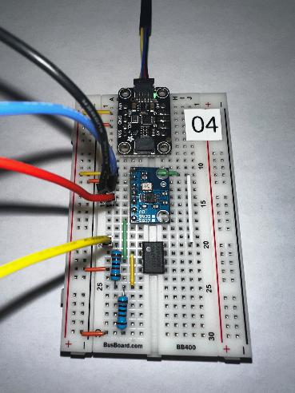
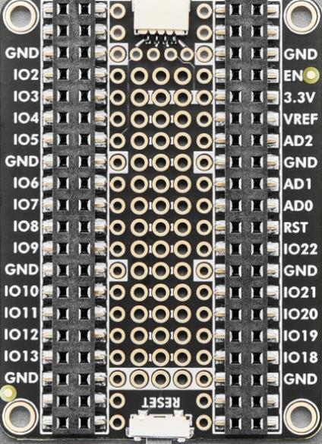
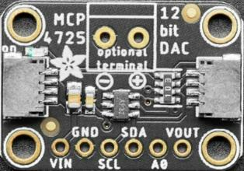
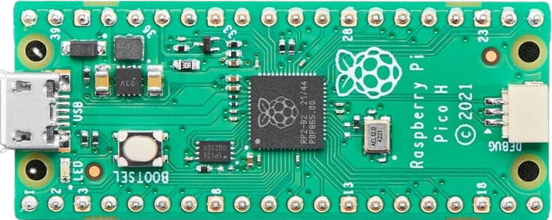
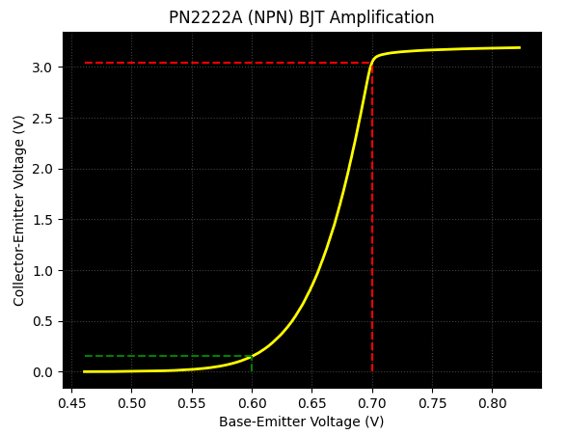

Control System Electronics 101
Using Python and Sensors to Measure Circuits
Board 08
Synchronous Circuits, Shift Registers
Dave Biersach
dbiersach@bnl.gov

Slide 2
Board 08 – Goals
Goal 1
Goal 2

Slide 3
Board 08 – Now You Know…
Goal 1
Goal 2

